Slide 1

Overview
Author: Wojciech Okoński

Slide 2

2010
The project started
Java SE 6 | 2006
Java SE 7 | 2011
Java SE 8 | 2014
Notes:
https://kotlinlang.org/docs/reference/faq.html
https://discuss.kotlinlang.org/t/history-of-kotlin-language/2161/5

Slide 3
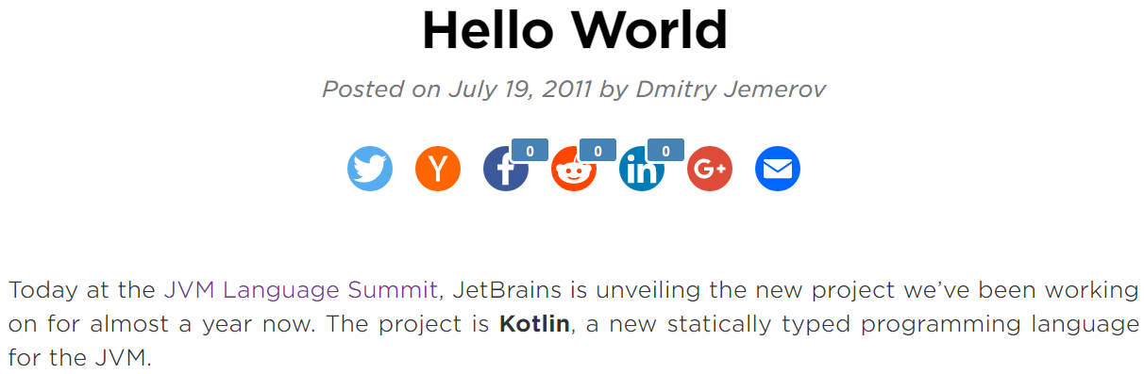
„hoping to provide a language which is productive enough for today’s environment and at the same time simple enough for the ordinary programmer to learn”
Notes:
https://blog.jetbrains.com/kotlin/2011/07/hello-world-2/
https://www.infoworld.com/article/2622405/java/jetbrains-readies-jvm-based-language.html

Slide 4
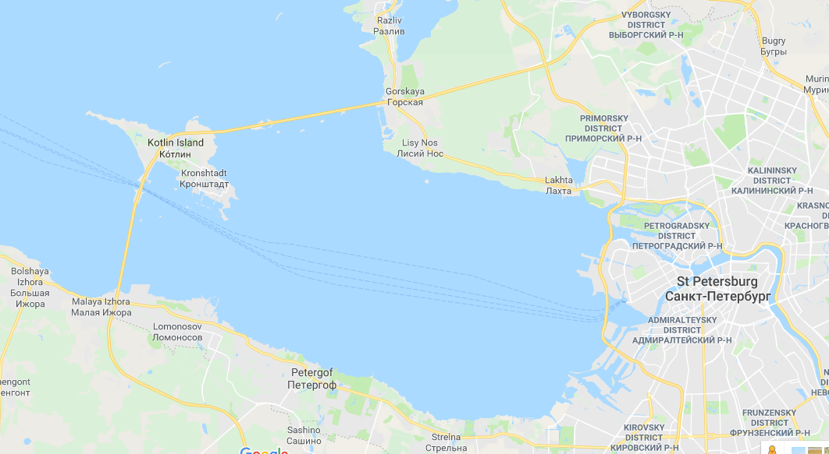
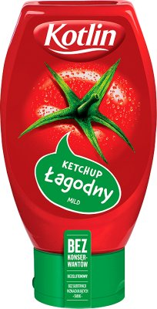
Notes:
https://en.wikipedia.org/wiki/Kotlin_(programming_language)

Slide 5
And what was then?
February 2012:
JetBrains open sourced the project under the Apache 2 license
February 15, 2016
Kotlin v1.0 was released
long-term backwards compatibility starting with this version
Notes:
https://en.wikipedia.org/wiki/Kotlin_(programming_language)

Slide 6
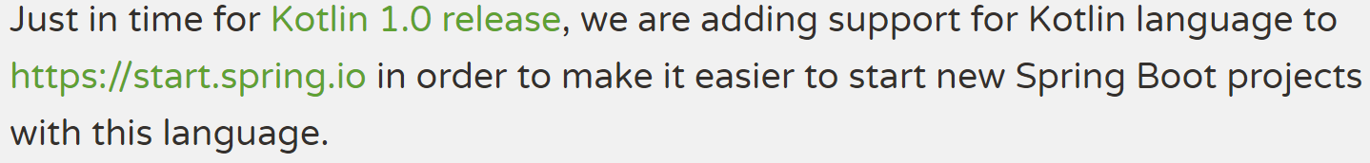
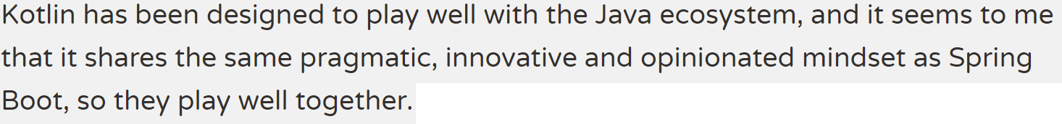
February 15, 2016 – THE SPRING BLOG
Notes:
https://spring.io/blog/2016/02/15/developing-spring-boot-applications-with-kotlin

Slide 7
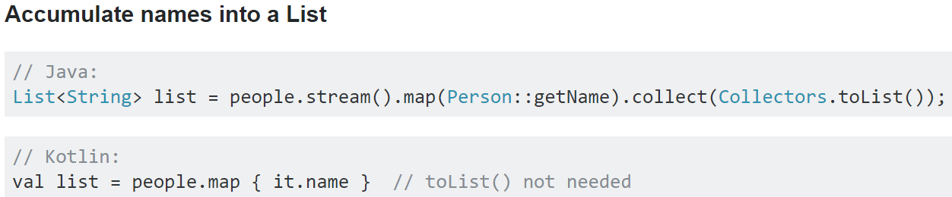
Notes:
https://stackoverflow.com/questions/34642254/what-java-8-stream-collect-equivalents-are-available-in-the-standard-kotlin-libr

Slide 8
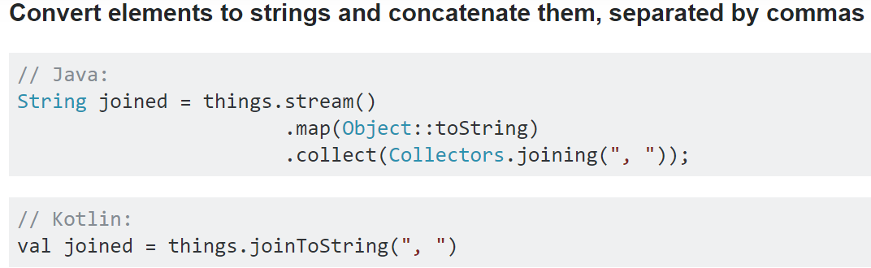
Notes:
https://stackoverflow.com/questions/34642254/what-java-8-stream-collect-equivalents-are-available-in-the-standard-kotlin-libr

Slide 9
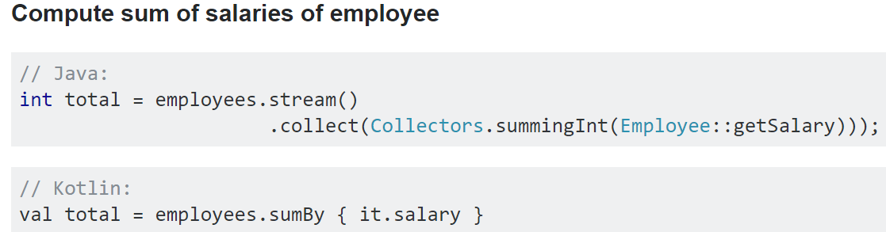
Notes:
https://stackoverflow.com/questions/34642254/what-java-8-stream-collect-equivalents-are-available-in-the-standard-kotlin-libr

Slide 10
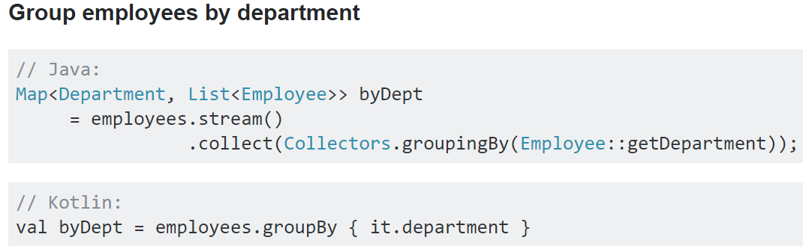
Notes:
https://stackoverflow.com/questions/34642254/what-java-8-stream-collect-equivalents-are-available-in-the-standard-kotlin-libr

Slide 11
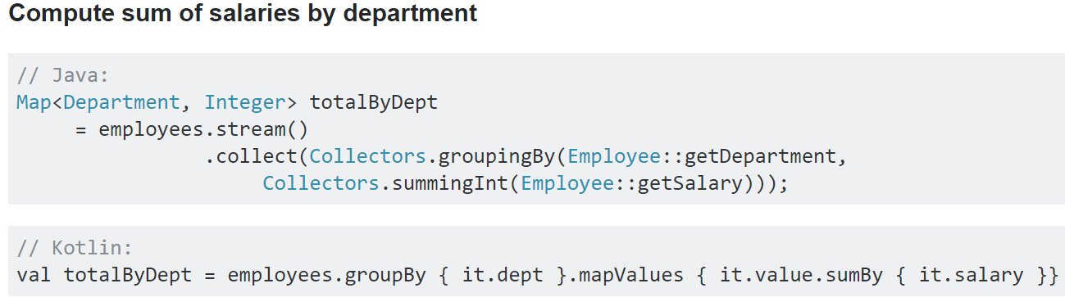
Notes:
https://stackoverflow.com/questions/34642254/what-java-8-stream-collect-equivalents-are-available-in-the-standard-kotlin-libr

Slide 12
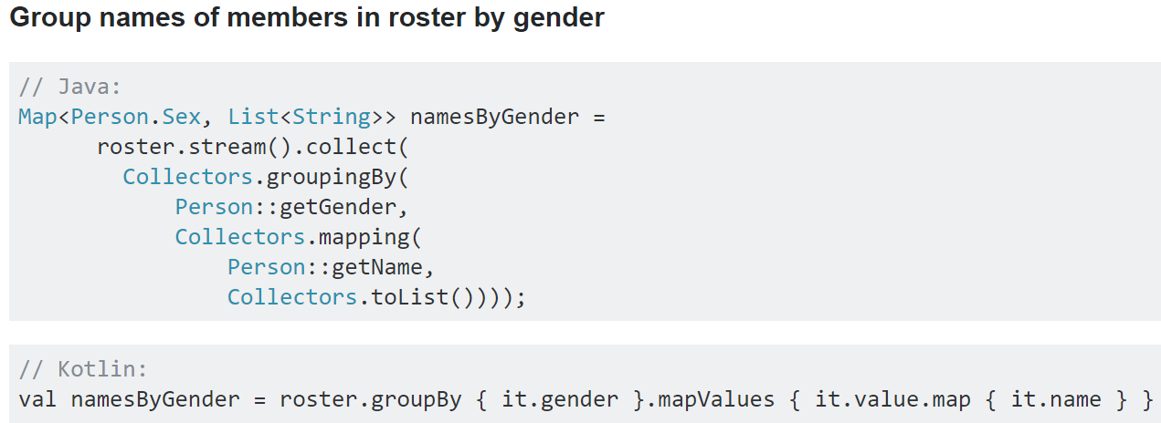
Notes:
https://stackoverflow.com/questions/34642254/what-java-8-stream-collect-equivalents-are-available-in-the-standard-kotlin-libr

Slide 13
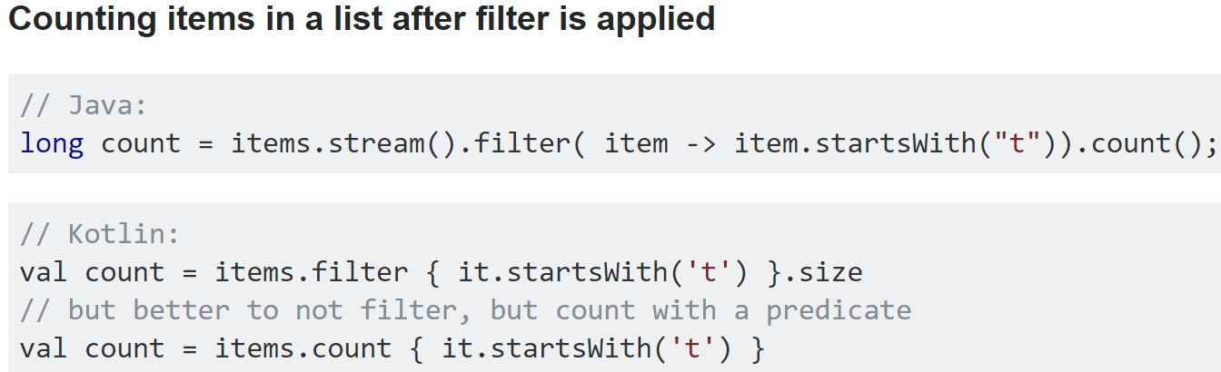
Notes:
https://stackoverflow.com/questions/34642254/what-java-8-stream-collect-equivalents-are-available-in-the-standard-kotlin-libr

Slide 14
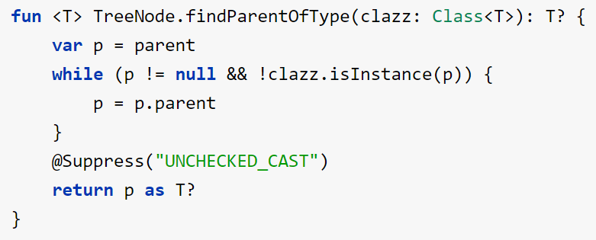
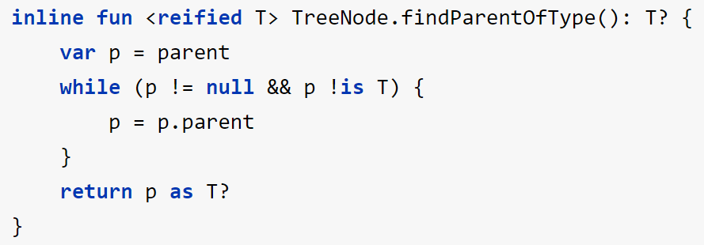
Reified type parameters
Notes:
https://kotlinlang.org/docs/reference/inline-functions.html

Slide 15
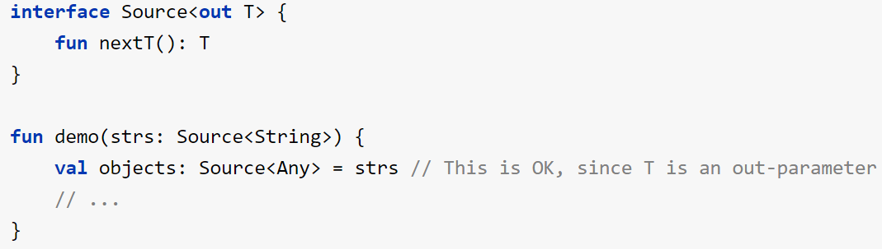
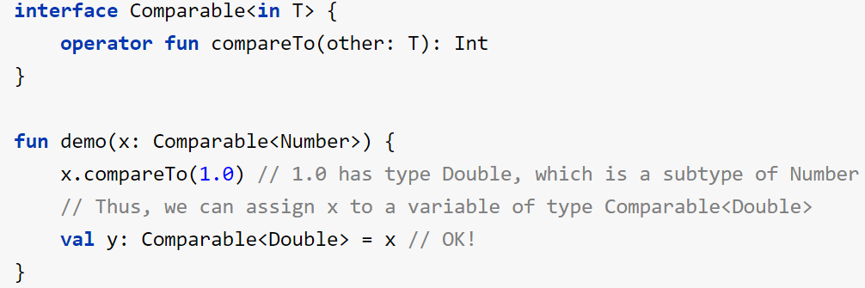
Declaration-site variance
Notes:
http://kotlinlang.org/docs/reference/generics.html

Slide 16
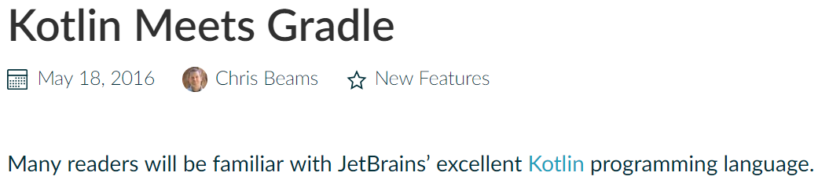
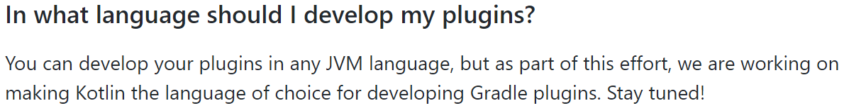
Notes:
https://blog.gradle.org/kotlin-meets-gradle
https://github.com/gradle/kotlin-dsl/wiki/Frequently-Asked-Questions

Slide 17
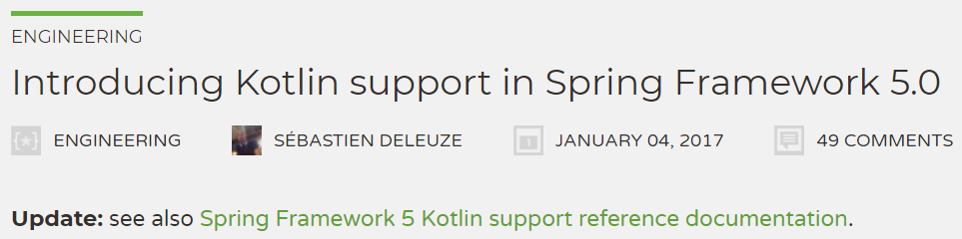
Kotlin extensions
Null-safety of Spring Framework API
@RequestParam name: String? (not required) etc.
Spring WebFlux functional DSL
Functional bean declaration DSL
Kotlin Script based templates
WebTestClient -> Kotlin 1.3
Notes:
https://spring.io/blog/2017/01/04/introducing-kotlin-support-in-spring-framework-5-0

Slide 18
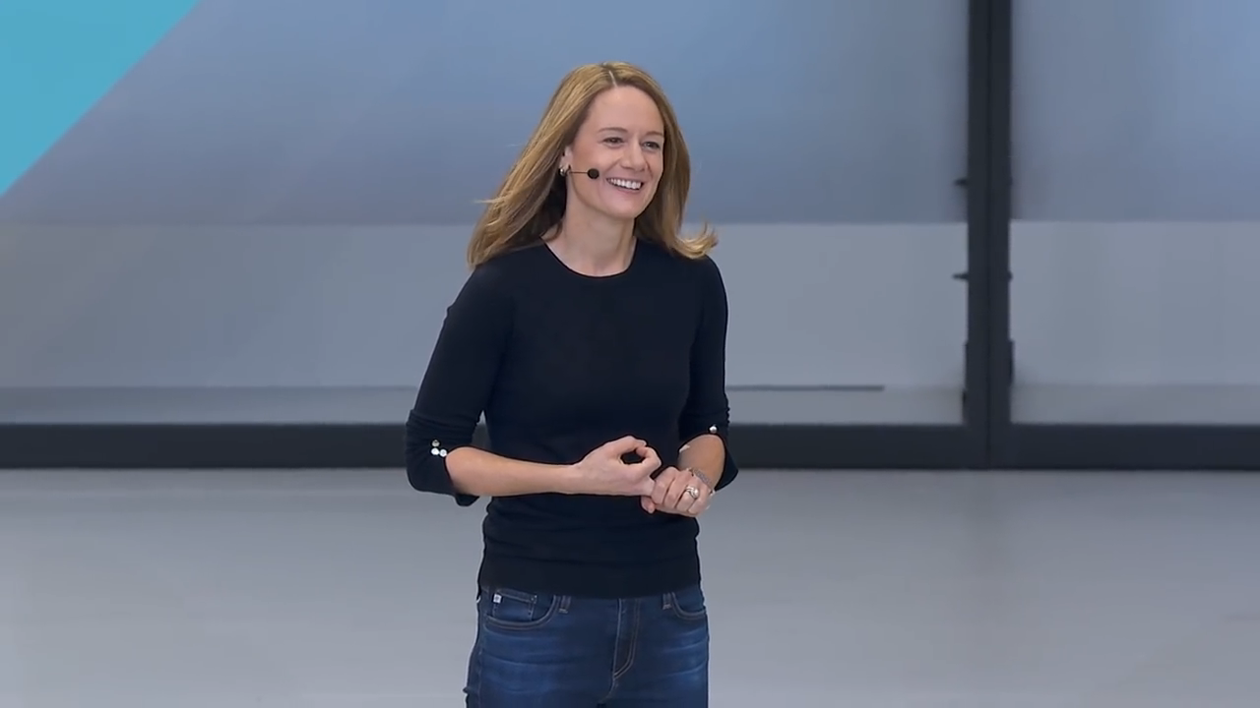
Google I/O '17 (17 maja 2017 r.)
Notes:
https://www.youtube.com/watch?v=Y2VF8tmLFHw

Slide 19
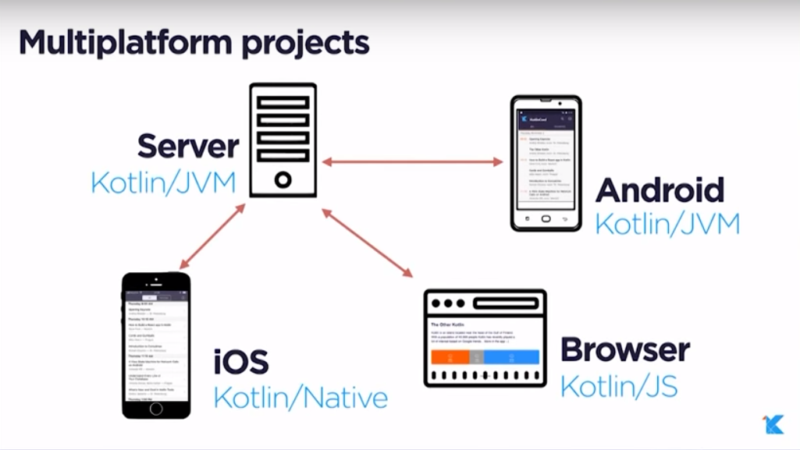
Notes:
https://www.youtube.com/watch?v=pjnHDXkeK-4
https://blog.jetbrains.com/kotlin/2017/11/kotlin-1-2-released/
https://github.com/JetBrains/create-react-kotlin-app

Slide 20
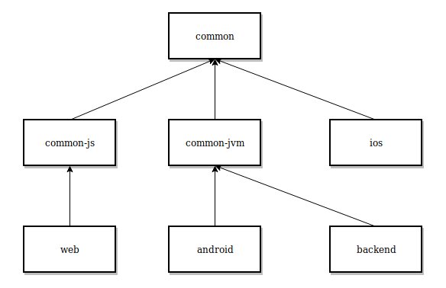
Notes:
https://blog.kotlin-academy.com/multiplatform-native-development-in-kotlin-now-with-ios-a8546f436eec

Slide 21
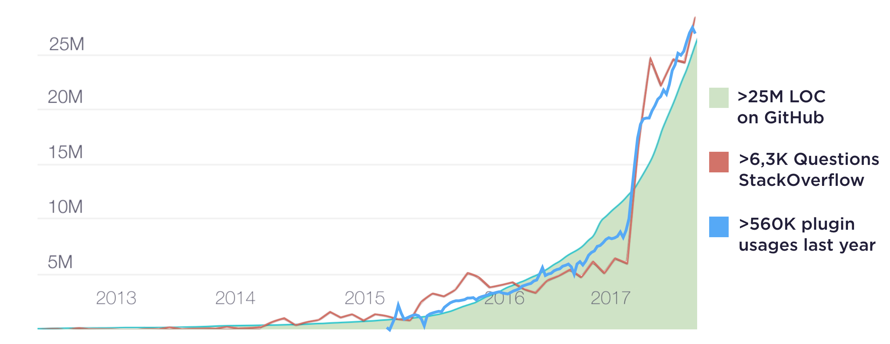

Slide 22
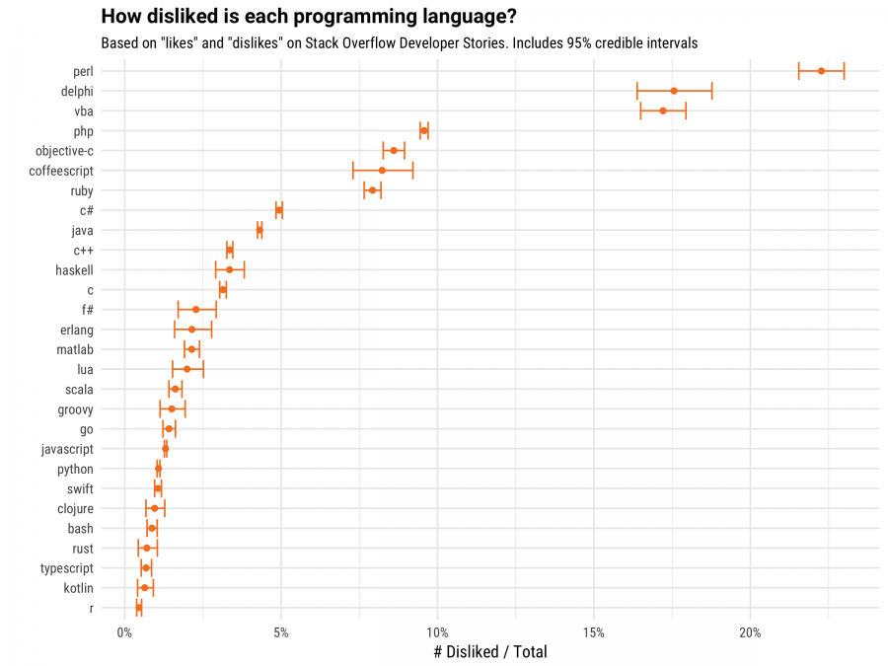

Slide 23
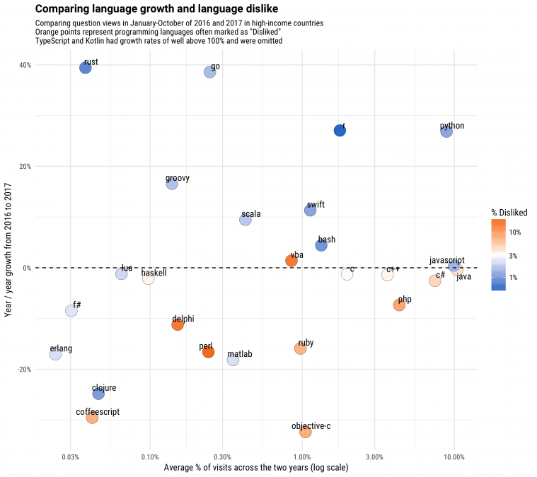

Slide 24
Recommended links
Learning:
https://kotlinlang.org/docs/tutorials/edu-tools-learner.html
http://kotlinlang.org/docs/reference/
https://kotlinlang.org/community/
Coroutines:
https://kotlinlang.org/docs/reference/coroutines.html
https://kotlinlang.org/docs/tutorials/coroutines-basic-jvm.html
https://github.com/Kotlin/kotlinx.coroutines/blob/master/coroutines-guide.md
KotlinConf 2017 (YouTube playlist)

Slide 25
Contact
wojteko22.96@gmail.com
https://www.facebook.com/wojteko22
https://www.linkedin.com/in/wojteko22
Demo & presentation: https://github.com/wojteko22/kotlin-demo

